Slide 1
Data Mining:
Concepts and Techniques
(3rd ed.)
— Chapter 6 —
Jiawei Han, Micheline Kamber, and Jian Pei
University of Illinois at Urbana-Champaign &
Simon Fraser University
©2011 Han, Kamber & Pei. All rights reserved.

Slide 2
Chapter 6. Classification: Basic Concepts
Classification: Basic Concepts
Decision Tree Induction
Bayes Classification Methods
Classification by Backpropagation
Model Evaluation and Selection
Summary

Slide 3
Supervised vs. Unsupervised Learning
Supervised learning (classification)
  Supervision: The training data (observations, measurements, etc.) are accompanied by labels indicating the class of the observations
  New data is classified based on the training set
Unsupervised learning (clustering)
  The class labels of training data is unknown
  Given a set of measurements, observations, etc. with the aim of establishing the existence of classes or clusters in the data

Slide 4
Prediction Problems: Classification vs. Numeric Prediction
Classification
  predicts categorical class labels (discrete or nominal)
  classifies data (constructs a model) based on the training set and the values (class labels) in a classifying attribute and uses it in classifying new data
Numeric Prediction
  models continuous-valued functions, i.e., predicts unknown or missing values
Typical applications
  Credit/loan approval:
  Medical diagnosis: if a tumor is cancerous or benign
  Fraud detection: if a transaction is fraudulent
  Web page categorization: which category it is

Slide 5
Classification—A Two-Step Process
Model construction: describing a set of predetermined classes
  Each tuple/sample is assumed to belong to a predefined class, as determined by the class label attribute
  The set of tuples used for model construction is training set
  The model is represented as classification rules, decision trees, or mathematical formulae
Model usage: for classifying future or unknown objects
  Estimate accuracy of the model
    The known label of test sample is compared with the classified result from the model
    Accuracy rate is the percentage of test set samples that are correctly classified by the model
    Test set is independent of training set (otherwise overfitting)
  If the accuracy is acceptable, use the model to classify new data
Note: If the test set is used to select models, it is called validation (test) set

Slide 6



Process (1): Model Construction
Classification
Algorithms
Training
Data
Classifier
(Model)
IF rank = ‘professor’
OR years > 6
THEN tenured = ‘yes’

Slide 7




Process (2): Using the Model in Prediction
Classifier
Testing
Data
Unseen Data
(Jeff, Professor, 4)
Tenured?

Slide 8
Chapter 6. Classification: Basic Concepts
Classification: Basic Concepts
Decision Tree Induction
Bayes Classification Methods
Classification by Backpropagation
Model Evaluation and Selection
Summary

Slide 9

Decision Tree Induction: An Example
Training data set: Buys_computer
The data set follows an example of Quinlan’s ID3 (Playing Tennis)
Resulting tree:
age?
<=30
overcast
>40
31..40
student?
yes
credit rating?
no
yes
excellent
fair
no
yes
no
yes

Slide 10
Algorithm for Decision Tree Induction
Basic algorithm (a greedy algorithm)
  Tree is constructed in a top-down recursive divide-and-conquer manner
  At start, all the training examples are at the root
  Attributes are categorical (if continuous-valued, they are discretized in advance)
  Examples are partitioned recursively based on selected attributes
  Test attributes are selected on the basis of a heuristic or statistical measure (e.g., information gain)
Conditions for stopping partitioning
  All samples for a given node belong to the same class
  There are no remaining attributes for further partitioning – majority voting is employed for classifying the leaf
  There are no samples left

Slide 11


Brief Review of Entropy
m = 2

Slide 12



Attribute Selection Measure: Information Gain (ID3/C4.5)
Select the attribute with the highest information gain
Let p_{i} be the probability that an arbitrary tuple in D belongs to class C_{i}, estimated by |C_{i, D}|/|D|
Expected information (entropy) needed to classify a tuple in D:
Information needed (after using A to split D into v partitions) to classify D:
Information gained by branching on attribute A
Notes:
I : the expected information needed to classify a given sample
E (entropy) : expected information based on the partitioning into subsets by A

Slide 13






Attribute Selection: Information Gain
Class P: buys_computer = “yes”
Class N: buys_computer = “no”
means “age <=30” has 5 out of 14 samples, with 2 yes’es and 3 no’s. Hence
Similarly,

Slide 14
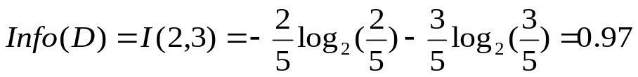
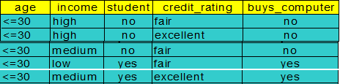
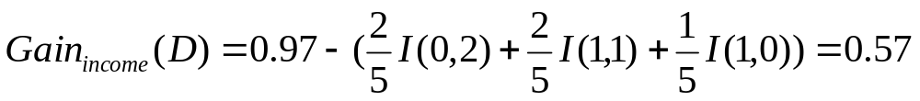
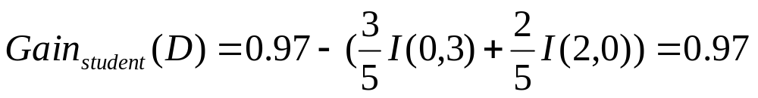
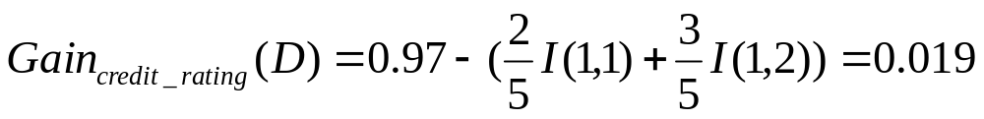
Attribute Selection: Information Gain
age?
For age <= 30 records:
<=30
31..40
>40
yes
We select “student” field to be the split field

Slide 15
Computing Information-Gain for Continuous-Valued Attributes
Let attribute A be a continuous-valued attribute
Must determine the best split point for A
  Sort the value A in increasing order
  Typically, the midpoint between each pair of adjacent values is considered as a possible split point
    (a_{i}+a_{i+1})/2 is the midpoint between the values of a_{i} and a_{i+1}
  The point with the minimum expected information requirement for A is selected as the split-point for A
Split:
  D1 is the set of tuples in D satisfying A ≤ split-point, and D2 is the set of tuples in D satisfying A > split-point

Slide 16

Gain Ratio for Attribute Selection (C4.5)
Information gain measure is biased towards attributes with a large number of values
C4.5 (a successor of ID3) uses gain ratio to overcome the problem (normalization to information gain)
  GainRatio(A) = Gain(A)/SplitInfo(A)
Ex.
  gain_ratio(income) = 0.029/1.557 = 0.019
The attribute with the maximum gain ratio is selected as the splitting attribute

Slide 17
Comparing Attribute Selection Measures
The three measures, in general, return good results but
  Information gain:
    biased towards multivalued attributes
  Gain ratio:
    tends to prefer unbalanced splits in which one partition is much smaller than the others

Slide 18
Overfitting and Tree Pruning
Overfitting: An induced tree may overfit the training data
  Too many branches, some may reflect anomalies due to noise or outliers
  Poor accuracy for unseen samples
Two approaches to avoid overfitting
  Prepruning: Halt tree construction early ̵ do not split a node if this would result in the goodness measure falling below a threshold
    Difficult to choose an appropriate threshold
  Postpruning: Remove branches from a “fully grown” tree—get a sequence of progressively pruned trees
    Use a set of data different from the training data to decide which is the “best pruned tree”

Slide 19
Chapter 6. Classification: Basic Concepts
Classification: Basic Concepts
Decision Tree Induction
Bayes Classification Methods
Classification by Backpropagation
Model Evaluation and Selection
Summary

Slide 20
Bayesian Classification: Why?
A statistical classifier: performs probabilistic prediction, i.e., predicts class membership probabilities
Foundation: Based on Bayes’ Theorem.
Performance: A simple Bayesian classifier, naïve Bayesian classifier, has comparable performance with decision tree and selected neural network classifiers
Incremental: Each training example can incrementally increase/decrease the probability that a hypothesis is correct — prior knowledge can be combined with observed data
Standard: Even when Bayesian methods are computationally intractable, they can provide a standard of optimal decision making against which other methods can be measured

Slide 21


Bayes’ Theorem: Basics
Total probability Theorem:
Bayes’ Theorem:
  Let X be a data sample (“evidence”): class label is unknown
  Let H be a hypothesis that X belongs to class C
  Classification is to determine P(H|X), (i.e., posteriori probability): the probability that the hypothesis holds given the observed data sample X
  P(H) (prior probability): the initial probability
    E.g., X will buy computer, regardless of age, income, …
  P(X): probability that sample data is observed
  P(X|H) (likelihood): the probability of observing the sample X, given that the hypothesis holds
    E.g., Given that X will buy computer, the prob. that X is 31..40, medium income

Slide 22
Prediction Based on Bayes’ Theorem
Given training data X, posteriori probability of a hypothesis H, P(H|X), follows the Bayes’ theorem
Informally, this can be viewed as
  posteriori = likelihood x prior/evidence
Predicts X belongs to C_{i} iff the probability P(C_{i}|X) is the highest among all the P(C_{k}|X) for all the k classes
Practical difficulty: It requires initial knowledge of many probabilities, involving significant computational cost

Slide 23


Classification Is to Derive the Maximum Posteriori
Let D be a training set of tuples and their associated class labels, and each tuple is represented by an n-D attribute vector X = (x₁, x₂, …, x_{n})
Suppose there are m classes C₁, C₂, …, C_{m}.
Classification is to derive the maximum posteriori, i.e., the maximal P(C_{i}|X)
This can be derived from Bayes’ theorem
Since P(X) is constant for all classes, only
  needs to be maximized

Slide 24



Naïve Bayes Classifier
A simplified assumption: attributes are conditionally independent (i.e., no dependence relation between attributes):
This greatly reduces the computation cost: Only counts the class distribution
If A_{k} is categorical, P(x_{k}|C_{i}) is the # of tuples in C_{i} having value x_{k} for A_{k} divided by |C_{i, D}| (# of tuples of C_{i} in D)
If A_{k} is continous-valued, P(x_{k}|C_{i}) is usually computed based on Gaussian distribution with a mean μ and standard deviation σ
  and P(x_{k}|C_{i}) is

Slide 25

Naïve Bayes Classifier: Training Dataset
Class:
C1:buys_computer = ‘yes’
C2:buys_computer = ‘no’
Data to be classified:
X = (age <=30,
Income = medium,
Student = yes
Credit_rating = Fair)

Slide 26
Naïve Bayes Classifier: An Example
P(C_{i}): P(buys_computer = “yes”) = 9/14 = 0.643
P(buys_computer = “no”) = 5/14= 0.357
Compute P(X|C_{i}) for each class
  P(age = “<=30” | buys_computer = “yes”) = 2/9 = 0.222
  P(age = “<= 30” | buys_computer = “no”) = 3/5 = 0.6
  P(income = “medium” | buys_computer = “yes”) = 4/9 = 0.444
  P(income = “medium” | buys_computer = “no”) = 2/5 = 0.4
  P(student = “yes” | buys_computer = “yes) = 6/9 = 0.667
  P(student = “yes” | buys_computer = “no”) = 1/5 = 0.2
  P(credit_rating = “fair” | buys_computer = “yes”) = 6/9 = 0.667
  P(credit_rating = “fair” | buys_computer = “no”) = 2/5 = 0.4
X = (age <= 30 , income = medium, student = yes, credit_rating = fair)
P(X|C_{i}) : P(X|buys_computer = “yes”) = 0.222 x 0.444 x 0.667 x 0.667 = 0.044
P(X|buys_computer = “no”) = 0.6 x 0.4 x 0.2 x 0.4 = 0.019
P(X|C_{i})*P(C_{i}) : P(X|buys_computer = “yes”) * P(buys_computer = “yes”) = 0.028
P(X|buys_computer = “no”) * P(buys_computer = “no”) = 0.007
Therefore, X belongs to class (“buys_computer = yes”)

Slide 27

Avoiding the Zero-Probability Problem
Naïve Bayesian prediction requires each conditional prob. be non-zero. Otherwise, the predicted prob. will be zero
Ex. Suppose a dataset with 1000 tuples, income=low (0), income= medium (990), and income = high (10)
Use Laplacian correction (or Laplacian estimator)
  Adding 1 to each case
    Prob(income = low) = 1/1003
    Prob(income = medium) = 991/1003
    Prob(income = high) = 11/1003
  The “corrected” prob. estimates are close to their “uncorrected” counterparts

Slide 28
Naïve Bayes Classifier: Comments
Advantages
  Easy to implement
  Good results obtained in most of the cases
Disadvantages
  Assumption: class conditional independence, therefore loss of accuracy
  Practically, dependencies exist among variables
    E.g., hospitals: patients: Profile: age, family history, etc.
      Symptoms: fever, cough etc., Disease: lung cancer, diabetes, etc.
    Dependencies among these cannot be modeled by Naïve Bayes Classifier
How to deal with these dependencies? Bayesian Belief Networks (Chapter 9)

Slide 29
Chapter 6. Classification: Basic Concepts
Classification: Basic Concepts
Decision Tree Induction
Bayes Classification Methods
Classification by Backpropagation
Model Evaluation and Selection
Summary

Slide 30
Classification by Backpropagation
Backpropagation: A neural network learning algorithm
Started by psychologists and neurobiologists to develop and test computational analogues of neurons
A neural network: A set of connected input/output units where each connection has a weight associated with it
During the learning phase, the network learns by adjusting the weights so as to be able to predict the correct class label of the input tuples
Also referred to as connectionist learning due to the connections between units

Slide 31
Neural Network as a Classifier
Weakness
  Long training time
  Require a number of parameters typically best determined empirically, e.g., the network topology or “structure.”
  Poor interpretability: Difficult to interpret the symbolic meaning behind the learned weights and of “hidden units” in the network
Strength
  High tolerance to noisy data
  Ability to classify untrained patterns
  Well-suited for continuous-valued inputs and outputs
  Successful on an array of real-world data, e.g., hand-written letters
  Algorithms are inherently parallel
  Techniques have recently been developed for the extraction of rules from trained neural networks

Slide 32
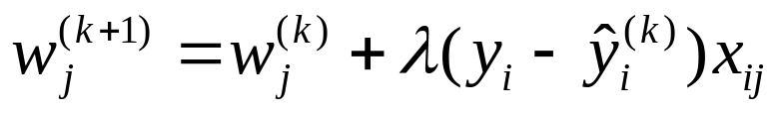
A Multi-Layer Feed-Forward Neural Network
Output vector
Output layer
Hidden layer
w_{ij}
Input layer
Input vector: X
Notes:
MK: Note – different notation than used in book. Will have to standardize notation.

Slide 33
How A Multi-Layer Neural Network Works
The inputs to the network correspond to the attributes measured for each training tuple
Inputs are fed simultaneously into the units making up the input layer
They are then weighted and fed simultaneously to a hidden layer
The number of hidden layers is arbitrary, although usually only one
The weighted outputs of the last hidden layer are input to units making up the output layer, which emits the network's prediction
The network is feed-forward: None of the weights cycles back to an input unit or to an output unit of a previous layer
From a statistical point of view, networks perform nonlinear regression: Given enough hidden units and enough training samples, they can closely approximate any function

Slide 34
Defining a Network Topology
Decide the network topology: Specify # of units in the input layer, # of hidden layers (if > 1), # of units in each hidden layer, and # of units in the output layer
Normalize the input values for each attribute measured in the training tuples to [0.0—1.0]
One input unit per domain value, each initialized to 0
Output, if for classification and more than two classes, one output unit per class is used
Once a network has been trained and its accuracy is unacceptable, repeat the training process with a different network topology or a different set of initial weights

Slide 35
Backpropagation
Iteratively process a set of training tuples & compare the network's prediction with the actual known target value
For each training tuple, the weights are modified to minimize the mean squared error between the network's prediction and the actual target value
Modifications are made in the “backwards” direction: from the output layer, through each hidden layer down to the first hidden layer, hence “backpropagation”
Steps
  Initialize weights to small random numbers, associated with biases
  Propagate the inputs forward (by applying activation function)
  Backpropagate the error (by updating weights and biases)
  Terminating condition (when error is very small, etc.)

Slide 36
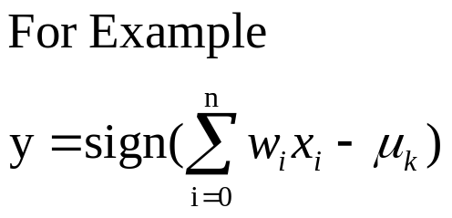
Neuron: A Hidden/Output Layer Unit
bias
μ_{k}
x₀
w₀
x₁
w₁
∑
f
output y
x_{n}
w_{n}
Input
vector x
weight
vector w
weighted
sum
Activation
function
An n-dimensional input vector x is mapped into variable y by means of the scalar product and a nonlinear function mapping
The inputs to unit are outputs from the previous layer. They are multiplied by their corresponding weights to form a weighted sum, which is added to the bias associated with unit. Then a nonlinear activation function is applied to it.

Slide 37
Efficiency and Interpretability
Efficiency of backpropagation: Each epoch (one iteration through the training set) takes O(|D| * w), with |D| tuples and w weights, but # of epochs can be exponential to n, the number of inputs, in worst case
For easier comprehension: Rule extraction by network pruning
  Simplify the network structure by removing weighted links that have the least effect on the trained network
  Then perform link, unit, or activation value clustering
  The set of input and activation values are studied to derive rules describing the relationship between the input and hidden unit layers
Sensitivity analysis: assess the impact that a given input variable has on a network output. The knowledge gained from this analysis can be represented in rules

Slide 38
Chapter 6. Classification: Basic Concepts
Classification: Basic Concepts
Decision Tree Induction
Bayes Classification Methods
Classification by Backpropagation
Model Evaluation and Selection
Summary

Slide 39
Model Evaluation and Selection
Evaluation metrics: How can we measure accuracy? Other metrics to consider?
Use validation test set of class-labeled tuples instead of training set when assessing accuracy
Methods for estimating a classifier’s accuracy:
  Holdout method, random subsampling
  Cross-validation
  Bootstrap
Comparing classifiers:
  Confidence intervals
  Cost-benefit analysis and ROC Curves

Slide 40
Classifier Evaluation Metrics: Confusion Matrix
Confusion Matrix:
Actual class\Predicted class | C₁ | ¬ C₁
C₁ | True Positives (TP) | False Negatives (FN)
¬ C₁ | False Positives (FP) | True Negatives (TN)
Example of Confusion Matrix:
Actual class\Predicted class | buy_computer = yes | buy_computer = no | Total
buy_computer = yes | 6954 | 46 | 7000
buy_computer = no | 412 | 2588 | 3000
Total | 7366 | 2634 | 10000
Given m classes, an entry, CM_{i,j} in a confusion matrix indicates # of tuples in class i that were labeled by the classifier as class j
May have extra rows/columns to provide totals

Slide 41
Classifier Evaluation Metrics: Accuracy, Error Rate, Sensitivity and Specificity
A\P | C | ¬C
C | TP | FN | P
¬C | FP | TN | N
 | P’ | N’ | All
Class Imbalance Problem:
  One class may be rare, e.g. fraud, or HIV-positive
  Significant majority of the negative class and minority of the positive class
  Sensitivity: True Positive recognition rate
    Sensitivity = TP/P
  Specificity: True Negative recognition rate
    Specificity = TN/N
Classifier Accuracy, or recognition rate: percentage of test set tuples that are correctly classified
  Accuracy = (TP + TN)/All
Error rate: 1 – accuracy, or
  Error rate = (FP + FN)/All

Slide 42




Classifier Evaluation Metrics:
Precision and Recall, and F-measures
Precision: exactness – what % of tuples that the classifier labeled as positive are actually positive
Recall: completeness – what % of positive tuples did the classifier label as positive?
Perfect score is 1.0
Inverse relationship between precision & recall
F measure (F₁ or F-score): harmonic mean of precision and recall,
F_{ß}: weighted measure of precision and recall
  assigns ß times as much weight to recall as to precision

Slide 43
Classifier Evaluation Metrics: Example
Actual Class\Predicted class | cancer = yes | cancer = no | Total | Recognition(%)
cancer = yes | 90 | 210 | 300 | 30.00 (sensitivity
cancer = no | 140 | 9560 | 9700 | 98.56 (specificity)
Total | 230 | 9770 | 10000 | 96.40 (accuracy)
  Precision = 90/230 = 39.13% Recall = 90/300 = 30.00%

Slide 44
Evaluating Classifier Accuracy:
Holdout & Cross-Validation Methods
Holdout method
  Given data is randomly partitioned into two independent sets
    Training set (e.g., 2/3) for model construction
    Test set (e.g., 1/3) for accuracy estimation
  Random sampling: a variation of holdout
    Repeat holdout k times, accuracy = avg. of the accuracies obtained
Cross-validation (k-fold, where k = 10 is most popular)
  Randomly partition the data into k mutually exclusive subsets, each approximately equal size
  At i-th iteration, use D_{i} as test set and others as training set
  Leave-one-out: k folds where k = # of tuples, for small sized data
  *Stratified cross-validation*: folds are stratified so that class dist. in each fold is approx. the same as that in the initial data

Slide 45

Model Selection: ROC Curves
ROC (Receiver Operating Characteristics) curves: for visual comparison of classification models
Originated from signal detection theory
Shows the trade-off between the true positive rate and the false positive rate
The area under the ROC curve is a measure of the accuracy of the model
Rank the test tuples in decreasing order: the one that is most likely to belong to the positive class appears at the top of the list
The closer to the diagonal line (i.e., the closer the area is to 0.5), the less accurate is the model
Vertical axis represents the true positive rate
Horizontal axis rep. the false positive rate
The plot also shows a diagonal line
A model with perfect accuracy will have an area of 1.0

Slide 46
Summary (I)
Classification is a form of data analysis that extracts models describing important data classes.
Effective and scalable methods have been developed for decision tree induction, Naive Bayesian classification, rule-based classification, and many other classification methods.
Evaluation metrics include: accuracy, sensitivity, specificity, precision, recall, F measure, and F_{ß} measure.
Stratified k-fold cross-validation is recommended for accuracy estimation. Bagging and boosting can be used to increase overall accuracy by learning and combining a series of individual models.

